Slide 1
Lecture 26

Slide 2
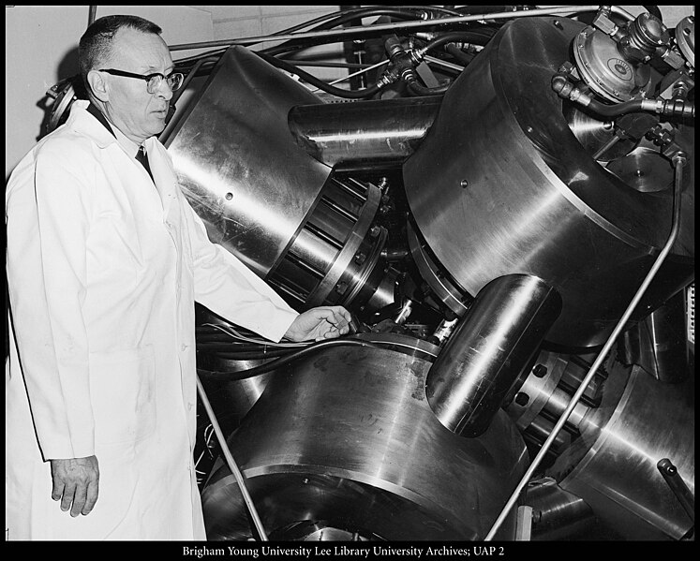

Slide 3
F_{out}
F_{in}
A_{in}
A_{out}

Slide 4






F_{in}
A_{in}
A_{in}
$$P_{t1}$$
$$P_{t2}=P_{t1}+∆P$$
$$h_{1}$$
$$h_{2}$$
$$P_{b1}$$
$$P_{b2}=P_{b1}+∆P$$

Slide 5
Problem
We push down on the small piston on the left. The pressure changes by an amount ΔP. How much does the pressure change in the right hand side of this jack?

Slide 6
Problem
We push down on the small piston on the left. The pressure changes by an amount ΔP. What is the upward force in the right hand side of the jack?

Slide 7
F_{atm}
F_{atm}
F_{in}
A_{in}
A_{in}
W
W
F_{fluid}
F_{fluid}

Slide 8
F_{atm}
F_{atm}
A_{out}
A_{out}
W
F_{out}
W
F_{fluid}
F_{fluid}

Slide 9
Pascal’s Law
If we change P_{o}, there must be a change in pressure throughout the entire fluid!
Pascal’s Law: a change in the pressure applied to a fluid is transmitted undiminished to every point of the fluid and to the walls of the container.

Slide 10
Question 123.4.7
Three containers are filled with water to the same height and have the same surface area at the base, but the total weight of water is different for each. Which container has the greatest total force acting on its base?
a) container 1
b) container 2
c) container 3
d) all three are equal
1
2
3

Slide 11
Question 123.4.8
How do Hydraulic Brakes Work?
A) The pressure due to the pedal being depressed compresses the fluid which then causes a force on the the brake pads
B) The force due to the pedal being depressed increases the pressure which is transmitted equally to the entire system, and causes a force on the brake pads
C) The force on the pedal causes a change in volume of the master cylinder which, in turn, causes there to be a higher pressure in the brake cylinder than exists in the master cylinder. This higher pressure causes a force on the brake pads

Slide 12
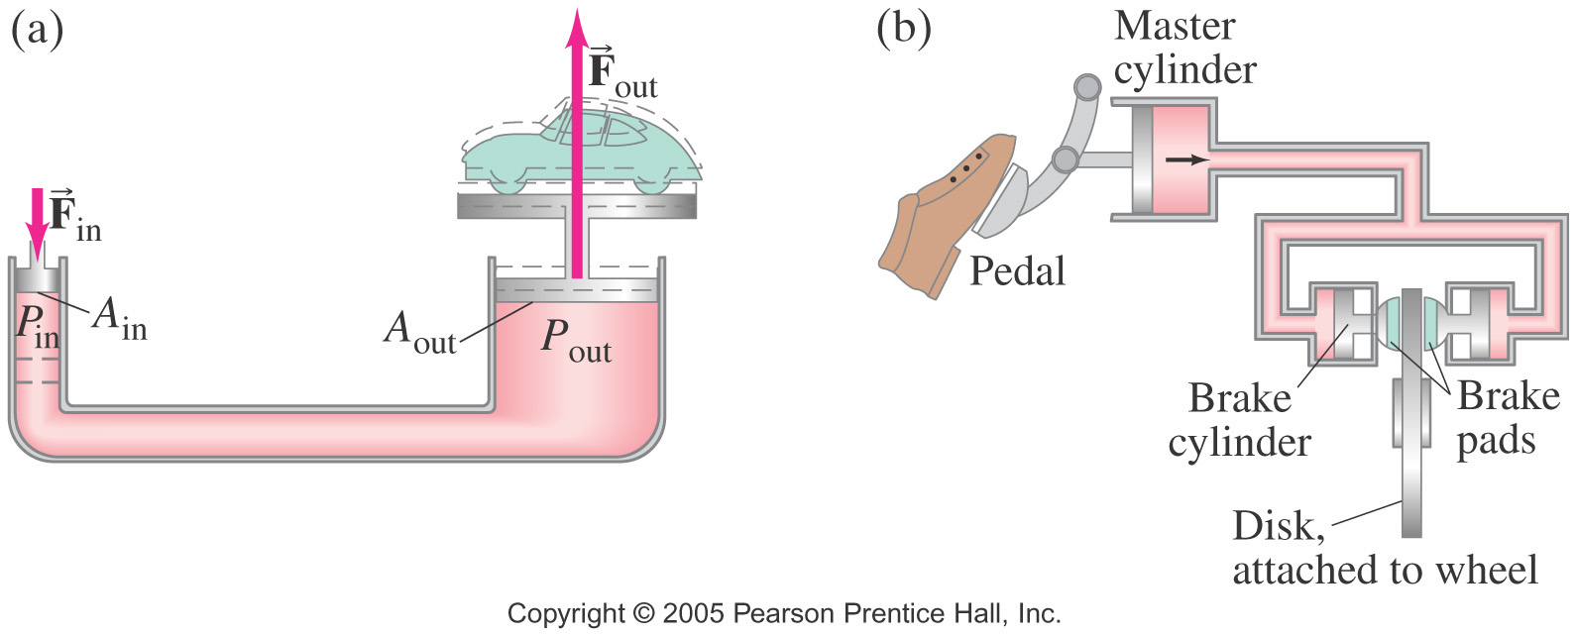
Question 123.4.8
How do Hydraulic Brakes Work?
A) The pressure due to the pedal being depressed compresses the fluid which then causes a force on the the brake pads
B) The force due to the pedal being depressed increases the pressure which increase is transmitted equally to the entire system, and causes a force on the brake pads
C) The force on the pedal causes a change in volume of the master cylinder which, in turn, causes there to be a higher pressure in the brake cylinder than exists in the master cylinder. This higher pressure causes a force on the brake pads

Slide 13
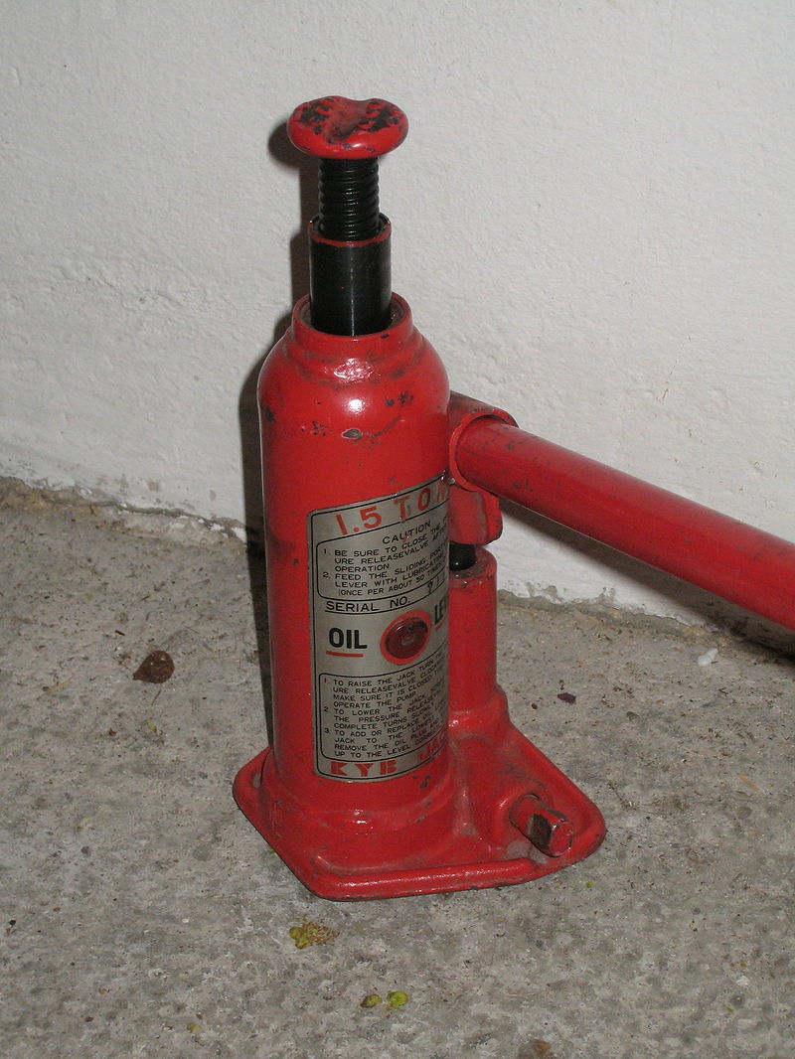
Small Cylinder
Big Cylinder

Slide 15




Buoyant Forces
Remember from
a stationary parcel of water there is a force that balances the weight of the parcel
Forces that act in the x-direction (sideways) balance each other
$${−P}_{t}A\hat{y}$$
$$P_{m}A_{m}\hat{x}$$
$${−P}_{m}A_{m}\hat{x}$$
Mg
$$P_{b}A\hat{y}$$

Slide 16
Question 123.5.3
Take a beach ball sized parcel of water. What happens if we replace the parcel with the beach ball?
The ball will rise because it is less dense than the water
The ball will rise because the buoyant force will be larger for the beach ball
The ball will rise because it’s surface area will be different than the parcel of water
B
W

Slide 17
Question 123.5.3.5
We say that there is a buoyant force acting on the beach ball. What is the buoyant force?
It is the net force on the beach ball
It is the net force due to the water pressure acting on the beach ball
It is a force that makes things float at the surface
50

Slide 18
Buoyant Forces
Now take a beach ball sized parcel of water
There is a force due to gravity and a force due to the pressure
What happens if we replace the parcel with the beach ball?
B
W

Slide 19


Archimedes’ Principle
The magnitude of the buoyant force always equals the weight of the fluid displaced by the object
For a cube
We know the force for a cube shaped parcel of water
$${F_{t}=−P}_{t}A\hat{y}$$
B
h
h
Where M is the mass of the parcel of water
Mg
$${F_{b}=P}_{b}A\hat{y}$$
W
By replacing the cube of water with a cube of another material, we have not changed the forces acting on the cube

Slide 20
Case1: Totally Submerged Object
The magnitude of the buoyant force is
Think Archimedes: The weight of the fluid displaced by the object. So we have the volume of the object as part of our equation
If the object has mass
B
V_{object}
h
The net force is
W
The motion of an object submerged in a fluid is determined only by the densities of the object and the fluid

Slide 21
Buoyant Forces
Now take a beach ball sized parcel of water
There is a force due to gravity and a force due to the pressure
What happens if we replace the parcel with the beach ball?
B
W

Slide 22
Case 2: Partially Submerged Object
Assume and static equilibrium.
We define V_{fluid} as the volume of the fluid displaced by the object.
Then
B
V_{displaced}
W
The fraction of the volume of a floating object that is below the fluid surface is equal to the ratio of the density of the object to that of the fluid.

Slide 23
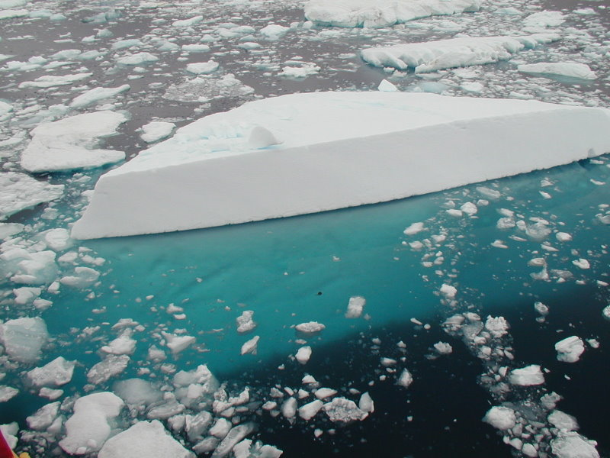
Iceberg with the submerged portion visible. From Geo Swan used under the licensed under the Creative Commons Attribution 2.0 Generic license.

Slide 24
Question 123.5.4
Two cups are filled to the same level with water. One of the two cups has ice cubes floating in it. When the ice cubes melt, in which cup is the level of the water higher?
h
A
B

Slide 25
Question 123.5.5
When a ball is floating on the surface of a pool, how does the force needed to push it under change with depth?
A
F
B
F
B
F_{g}
h
h
h
F
C
h

Slide 26

Question 123.5.6
I have somehow suspended a block of concrete in a fluid. I replace the concrete with a block of Styrofoam with equal volume. The buoyant force on the Styrofoam is
Larger than
smaller than
the same as
The buoyant force on the concrete.

Slide 27
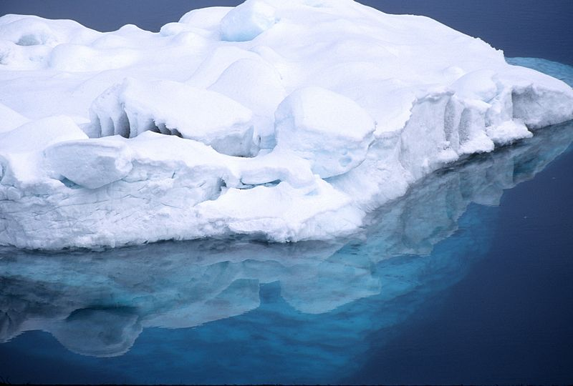

Slide 28
End

Slide 29
Question 123.5.1
P=0
If the barometer shown here were used on Mars, would h be larger or smaller
Larger
Smaller
h
P_{o}

Slide 30

Question 123.5.2
The pressure at point A in this monometer is ________ the pressure at point B
higher than
lower than
the same as
Pipe with a higher pressure, P_{pipe} that we wish to measure
Δh
A
B
P_{A}
P_{B}

Slide 31
P_{t} = 0
P_{t} = P_{atm}
h
A
B

Slide 32
Pressure Measurement: Barometer
P_{t} = 0
In many pressure measurements, the idea is to make the pressure due to a column of fluid equal to the pressure to be measured
For the barometer,
We solve for the height of the liquid (usually Hg)
Would a water be practical to use for a barometer?
P_{t} = P_{atm}
h
A
B

Slide 33
Pressure Measurement: Barometer
P_{t} = 0
In many pressure measurements, the idea is to make the pressure due to a column of fluid equal to the pressure to be measured
For the barometer,
We solve for the height of the liquid.
For water this would be
P_{t} = P_{atm}
h
A
B

Slide 34
Pipe with a higher pressure, P_{pipe} that we wish to measure
Δh
A
B
P_{A}
P_{B}

Slide 36
Question 123.5.3
Take a beach ball sized parcel of water. What happens if we replace the parcel with the beach ball?
The ball will rise because it is less dense than the water
The ball will rise because the buoyant force will be larger for the beach ball
The ball will rise because it’s surface area will be different than the parcel of water
B
F_{g}

Slide 37
Question 123.5.3.5
We say that there is a buoyant force acting on the beach ball. What is the buoyant force?
It is the net force on the beach ball
It is the net force due to the water pressure acting on the beach ball
It is a force that makes things float at the surface
50

Slide 38
Buoyant Forces
Remember from
a stationary parcel of water there is a force that balances the weight of the parcel
Forces that act in the x-direction (sideways) balance each other
-P_{o}Aĵ
P_{m}A x
-P_{m}A x
j
PAĵ
i
Mg

Slide 39
Buoyant Forces
Now take a beach ball sized parcel of water
There is a force due to gravity and a force due to the pressure
What happens if we replace the parcel with the beach ball?
B
W

Slide 40
Archimedes’ Principle
The magnitude of the buoyant force always equals the weight of the fluid displaced by the object
For a cube
F_{t}=-P_{o}Aĵ
We know the force for a cube shaped parcel of water
B
h
h
Where M is the mass of the parcel of water
Mg
F_{b}=PAĵ
W
By replacing the cube of water with a cube of another material, we have not changed the forces acting on the cube

Slide 41
Case1: Totally Submerged Object
The magnitude of the buoyant force is
Think Archimedes: The weight of the fluid displaced by the object. So we have the volume of the object as part of our equation
If the object has mass
B
V_{object}
h
The net force is
F_{g}
The motion of an object submerged in a fluid is determined only by the densities of the object and the fluid

Slide 42
Buoyant Forces
Now take a beach ball sized parcel of water
There is a force due to gravity and a force due to the pressure
What happens if we replace the parcel with the beach ball?
B
W

Slide 43
Case 2: Partially Submerged Object
Assume and static equilibrium.
We define V_{fluid} as the volume of the fluid displaced by the object.
Then
B
V_{displaced}
W
The fraction of the volume of a floating object that is below the fluid surface is equal to the ratio of the density of the object to that of the fluid.

Slide 44
Iceberg with the submerged portion visible. From Geo Swan used under the licensed under the Creative Commons Attribution 2.0 Generic license.

Slide 45
Question 123.5.4
Two cups are filled to the same level with water. One of the two cups has ice cubes floating in it. When the ice cubes melt, in which cup is the level of the water higher?
h
A
B

Slide 46
Question 123.5.5
When a ball is floating on the surface of a pool, how does the force needed to push it under change with depth?
A
F
B
F
B
F_{g}
h
h
h
F
C
h

Slide 47
Question 123.5.6
I have somehow suspended a block of concrete in a fluid. I replace the concrete with a block of Styrofoam with equal volume. The buoyant force on the Styrofoam is
Larger than
smaller than
the same as
The buoyant force on the concrete.

Slide 49
End

Slide 50
Misplaced Slides

Slide 51
Question 123.10.1
In the work energy theorem, ΔK = ?
W
U
F
0.5mv²
²

Slide 52
Question 123.10.2
Mechanical work is defined as …
F/A
0.5mv²
PH 123

Slide 53
Question 123.10.2.4
The quantity ΔU = ?
-W
K
F
45.3mv²
²

Slide 54
Question 123.10.2.5
A force, F, does work. Which of the F vs x diagrams represents the most work done?
F
B
A
A
x
F
B
B
A
x

Slide 55
Question 123.10.3
Is mechanical energy conserved?
Yes
No
Maybe sometimes

Slide 56
Question 123.10.4
How much heat is contained in this room?
100000J
100000K
100000BTU
This is a dumb question, rooms don’t “contain” heat.

Slide 57
P_{i} V_{i}
F_{ex}
F_{p}
Δx
P_{f} V_{f}
F_{ex}
F_{p}

Slide 58
ACME Pianos
UP
N_{BF}
N_{BL}
N_{B6}
f_{BFk}
W_{BE}

Slide 59
P
P_{i}
P_{f}
V
V_{i}
V_{f}

Slide 60
P
P_{i}
P_{f}
V
V_{i}
V_{f}

Slide 61
P
P_{i}
P_{f}
V
V_{i}
V_{f}

Slide 62
P
P
P
P_{i}
P_{i}
P_{i}
P_{f}
P_{f}
P_{f}
V_{i}
V_{f}
V
V_{i}
V_{f}
V
V
V_{i}
V_{f}

Slide 63
Question 123.10.5
Which PV graph represents a cyclic process?
A
B
C

Slide 64
Question 123.10.6
By observing a system we find that
W = -Q
What can we say about the system?
It is isolated
It is cyclic
It is isobaric
It is closed

Slide 65
Question 123.10.6
Which graph represent the most work done on the system?
P
P
P
P_{i}
P_{i}
P_{i}
P_{f}
P_{f}
P_{f}
V_{i}
V_{f}
V
V_{i}
V_{f}
V
V_{i}
V
V_{f}
A B C

Slide 70
Question 123.10.7
The initial state of a system is shown, if the membrane is broken, the gas fills the entire container. Is there work done by the gas in filling the container?
Yes
No
Can’t Tell
Vacuum
Membrane
Gas at T_{i}

